Slide 1



Heart Disease Analysis
View in Power BI
Last data refresh:
4/11/2024 10:04:45 AM UTC
Downloaded at:
4/15/2024 2:21:18 PM UTC

Slide 2
INTRODUCTION
The World Health Organization (WHO) reports a staggering 17.9 million deaths annually from cardiovascular diseases, making them the leading cause of death and costing a hefty $272 billion globally. The good news: 80% of these premature deaths are preventable through healthy choices and early detection. This analysis could become a significant step towards the early detection.

Slide 3
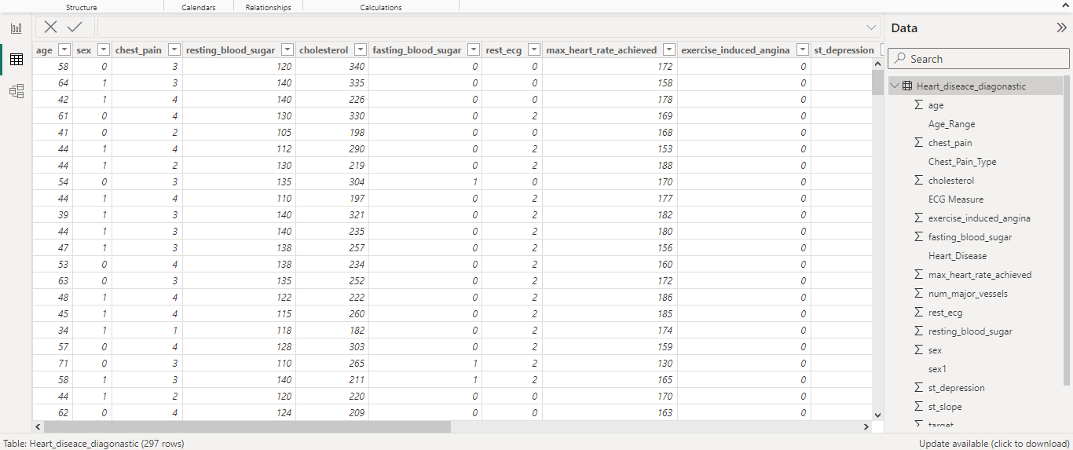
Data Collection: The dataset I used for my analysis had provided me by Unified Mentor (a remote internship provider). The dataset includes information on product (item) types, their retail prices, unit sold, unit cost, order and ship dates, geographical information, sales channels and more. Challenges in data cleaning, profiling and normalization were addressed using Microsoft Excel and Query Editor on Power BI to ensure the accuracy of the analysis.

Slide 4
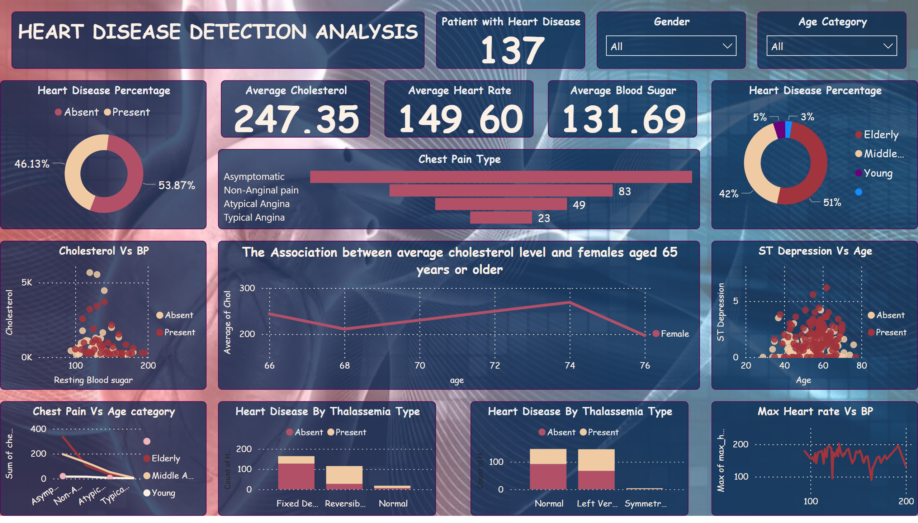
Page 1
Notes:
textbox
No alt text provided
The Association between average cholesterol level and females aged 65 years or older
No alt text provided
Max Heart rate Vs BP
No alt text provided
Heart Disease By Thalassemia Type
No alt text provided
Chest Pain Vs Age category
No alt text provided
ST Depression Vs Age
No alt text provided
Cholesterol Vs BP
No alt text provided
Chest Pain Type
No alt text provided
Heart Disease Percentage
No alt text provided
Average Heart Rate
No alt text provided
Average Blood Sugar
No alt text provided
Average Cholesterol
No alt text provided
Heart Disease Percentage
No alt text provided
Age Category
No alt text provided
Gender
No alt text provided
Patient with Heart Disease
No alt text provided
Heart Disease By Thalassemia Type
No alt text provided

Slide 5
Analysis summary based on number of patients:
Recommendations Based on Analysis:
Considering that the age group of 40-70 years exhibits the highest incidence of reported heart-related discomfort, individuals within this demographic should prioritize lifestyle modifications. Medical institutions can enhance and allocate their services to cater specifically to this age group.
Any abnormalities detected in crucial features, particularly in Max Heart Rate (Thalach), Cholesterol, and Exercise Capacity Score, should prompt individuals to seek a medical checkup for a comprehensive diagnosis of potential causes.
Addressing Potential Areas for Further Research:
It's essential to approach the analysis cautiously, acknowledging certain limitations in the dataset, such as its relatively small size, the presence of binary variables (e.g., 'target,' 'sex'), and potential biases. Additionally, my analysis lacks domain-specific expertise.
For the 'target,' the general assumption is that 0 represents 'No heart disease,' while 1 indicates 'Heart Disease.'
Regarding 'sex,' the general assumption is that 0 corresponds to 'Female,' and 1 corresponds to 'Male.'.

Slide 6
Conclusion:
This project aimed to meticulously clean and preprocess the dataset, conducting a thorough analysis using pertinent features and metrics. The goal was to unveil potential patterns and insights, fostering a comprehensive understanding to optimize the heart's health conditions.

Slide 7
THANK YOU

